Slide 1



Runtime-rs
Project updates
Roadmap
Product-ready discussion
Chao Wu

Slide 2



Project updates – feature updates
It has been 1 year since runtime-rs released…
The community have added several features to the runtime-rs
Multi-hypervisor support (CLH、QEMU、Firecracker)
upcall features
Device manager support
Nydus support
Cpu hotplug support
Vhost device support
…

Slide 3
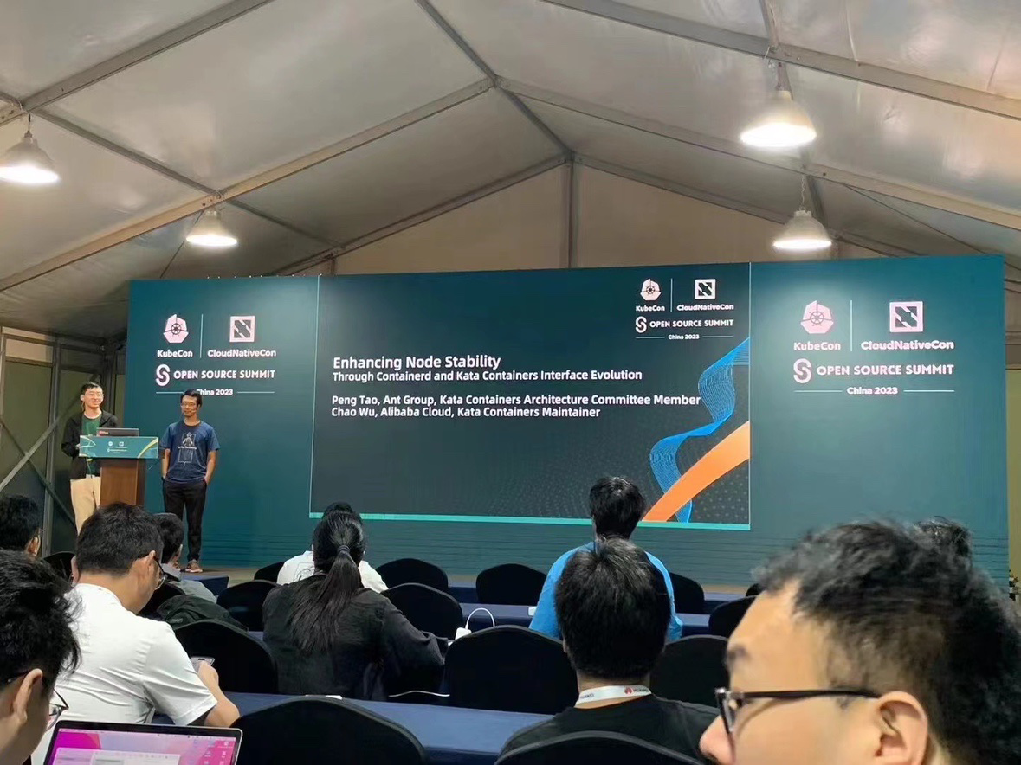
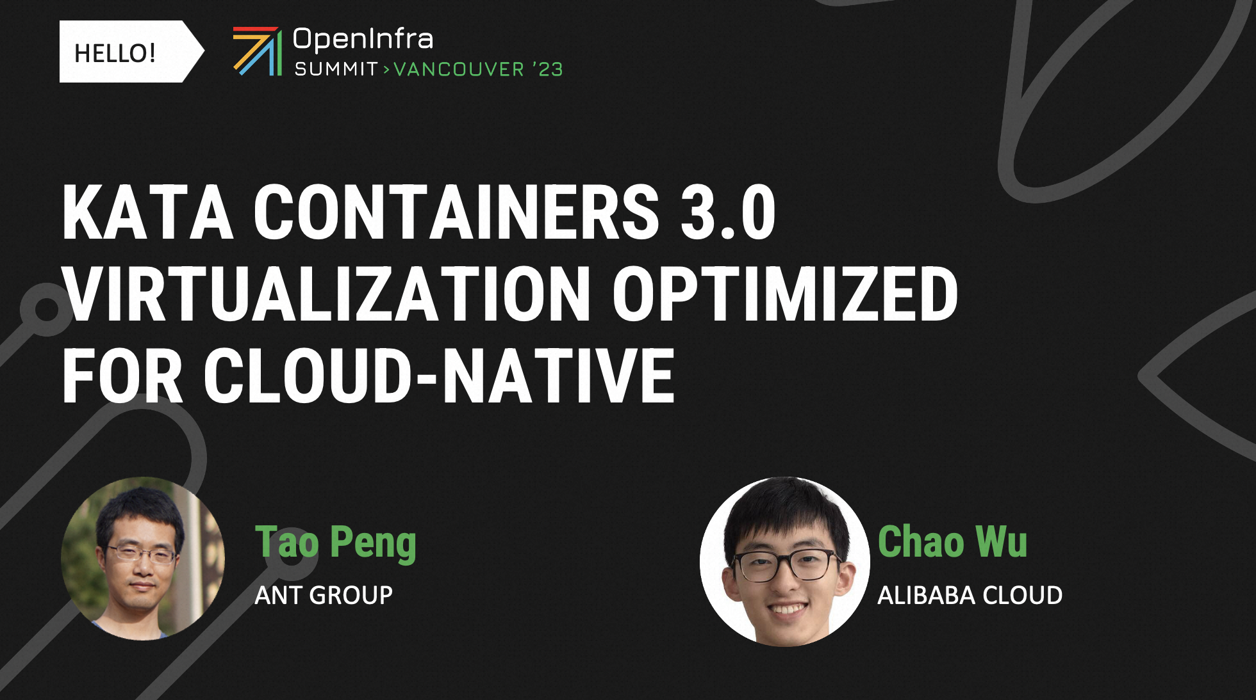
Project updates – community updates
We also went to different conferences to promote runtime-rs + Dragonball
OpenInfra Summit Vancouver
Introduction for Kata Containers 3.0
KubeCon Shanghai
Introduction for Sandbox API with Kata

Slide 4
Then … What?
We realize there are still several important feature gaps for runtime-rs & Dragonball, which makes user hard
to actually use them in the production environment…
For example,
PCI VFIO support
PCI VFIO hotplug / hot-unplug
CoCo Support
memory hotplug

Slide 5
Goal – Product Ready
With all those missing pieces, we are determined to fix that situation.
Before 12/30, we would like to complete several major features gap except Confidential Container part, e.g.
PCI VFIO support & Hotplug
Memory hotplug
Better GPU support
After that, we would like to announce that runtime-rs is product ready and ready for community to actually use it.
And we will begin to encouraging several community developments start based on runtime-rs
We hope to open-source the Confidential Container support for runtime-rs + Dragonball before Mid 2024, and
start encouraging CoCo doing work also on runtime-rs

Slide 6


Thank You

